Slide 1
INSURANCE PREDICTION
(MAJOR PROJECT)
GROUP MEMBERS:
ALWIN JOJY
ANUSREE MANOJ
MANOJ R
ALAN J NORBERT

Slide 2
NTRODUCTION
Objective:
Develop a machine learning model to predict individual insurance costs based on key demographic and health-related factors, including sex, smoker status, body mass index (BMI), region of residence, age, and the number of children.
Significance:
Enables accurate risk assessment and fair premium pricing for insurance companies.
Promotes transparency and fairness in premium calculation for individuals.
Encourages healthier lifestyle choices by highlighting the impact of factors like smoking and BMI on insurance costs.

Slide 3
DATA SET
1)Age:
Age is a critical factor in determining risk, as older individuals often face higher health-related expenses.
2) Region:
The region variable accounts for geographical differences in healthcare costs, regulatory environments, and access to medical services, all of which can significantly impact insurance pricing.

Slide 4
DATA SET
Smoker status :
The smoker status of individuals, which is a significant determinant of health risks and, insurance charges. Smokers typically incur higher medical costs due to smoking-related conditions, making this variable essential for accurate predictions.
Sex
The sex variable provides insights into gender-specific health trends.
BMI
BMI serves as an important indicator of an individual’s health status, affecting both risk assessment and insurance pricing.
Number of children:
The number of children can reflect family health dynamics, potentially influencing coverage needs and costs.

Slide 5
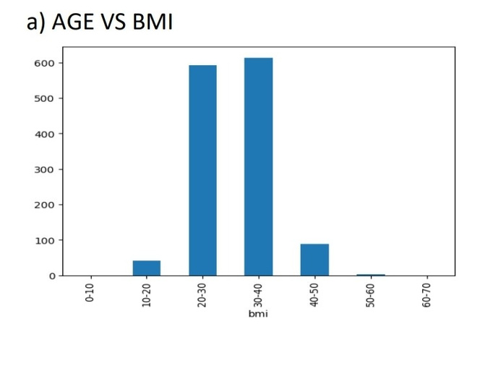
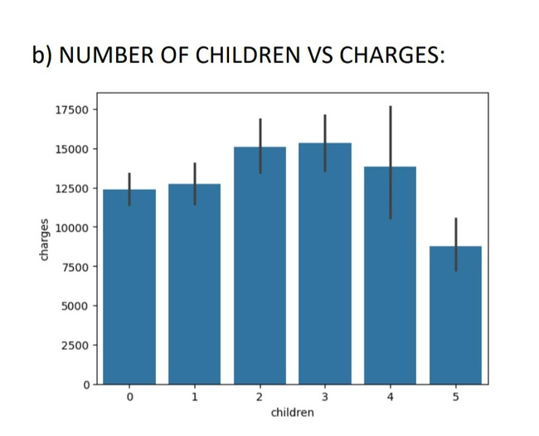
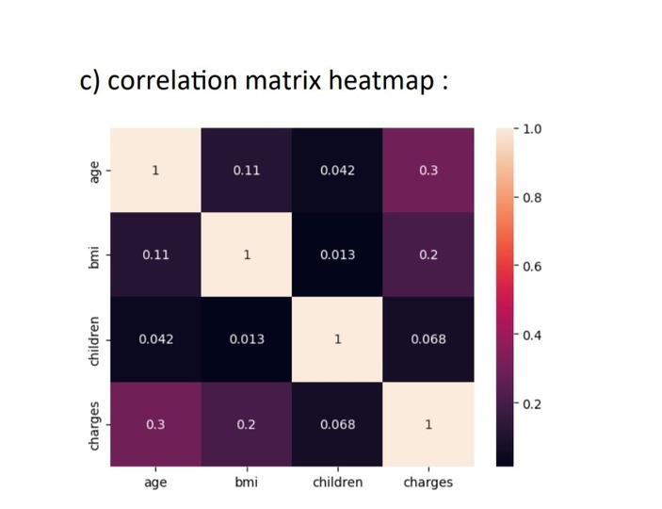
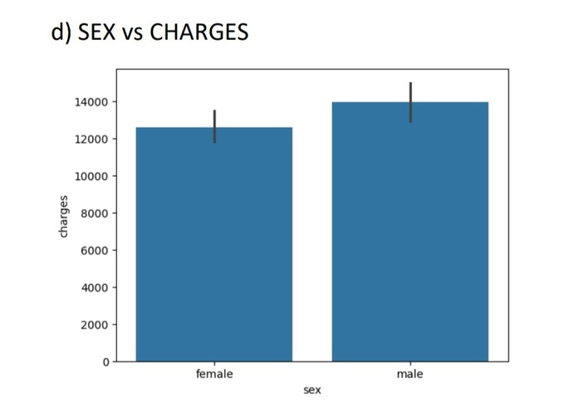
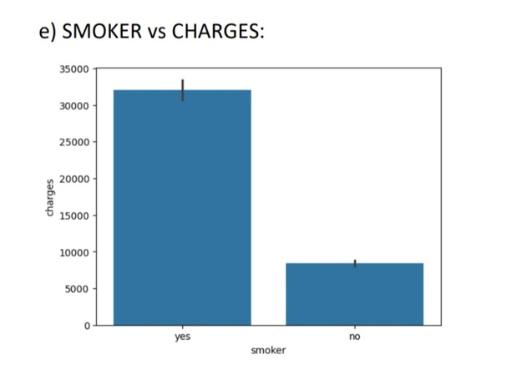
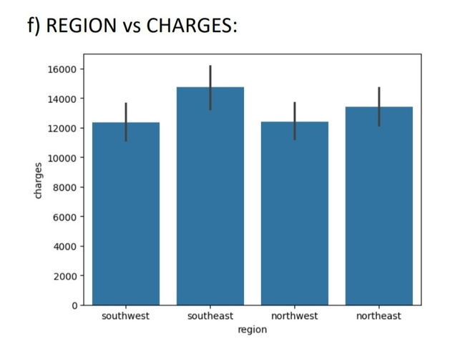
DATA VISUALIZATION

Slide 6
DATA PREPROCESSING
1)1)Encoding Categorical Variables:
Standard Scalar:
Splitting of data:
a)Label Encoding: Machine learning algorithms require numerical input. Categorical variables (like "sex," "smoker," or "region") need to be converted into a numerical format. (e.g., "male" = 0, "female" = 1).
Standardizes features by removing the mean and scaling to unit variance (i.e., a mean of 0 and a standard deviation of 1).
To avoid overfitting and to assess model performance, it's important to train the model on one portion of the data and evaluate it on unseen data. The dataset is split into training (e.g., 80%) and testing sets (e.g., 20%). The model is trained on the training set, while the test set is used to evaluate performance on unseen data.

Slide 7

MODELS
1) Decision trees
2) Random Forest
3) Gradient boosting
Interpretability
Handling Non-Linear Relationships
Feature Importance
Improved Accuracy
Handles Overfitting
Robustness to Outliers and Noise
Feature Importance
Higher Accuracy
Handles Imbalanced Data
Robust to Overfitting
Handles Complex Data

Slide 8
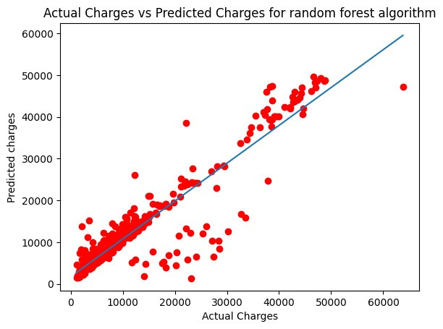
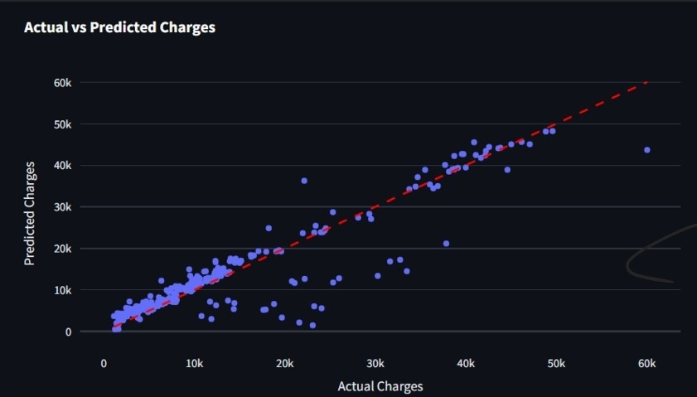
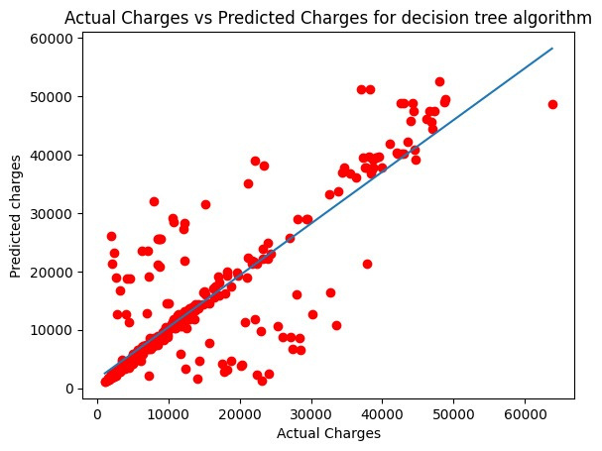
GRADIENT BOOSTING
PREDICTED
vs
ACTUAL VALUES

Slide 9
RESULTS
1) Decision trees
2) Random Forest
3) Gradient boosting
1) Decision trees
MSE: 38149364.68
R² value: 0.739
MSE: 38149364.680
R² value: 0.853
MSE: 21696987.02
R² value: 0.860
EVALUATION
Mean Squared Error (MSE): MSE measures the average squared difference between predicted and actual values, indicating how well a model's predictions align with the observed data—lower values signify better model performance.
R-Squared (R²): R² quantifies the proportion of variance in the dependent variable that can be explained by the independent variables in the model, with values closer to 1 indicating a better fit.
On the basis of MSE values and R² values, Gradient boosting model can be regarded as the best performing model among all three models.

Slide 10
Model Deployment
The model is deployed using Streamlit, which provides an interactive and visually appealing user interface.
Users can:
⦁ Predict their insurance charges based on the input features.
⦁ Contribute new data to improve the model’s predictions.
⦁ Visualize the model’s performance and feature importance.
The app was styled using custom CSS for a clean, professional look with interactive elements and responsive animations.

Slide 11
APPLICATION FEATURES
1 )Home Page
The home page of the application displays a description of the dataset, along with visualizations for:
⦁ Actual vs Predicted Charges: A scatter plot comparing actual charges to predicted charges.
⦁ Feature Importance: A bar plot showing the relative importance of each feature in predicting insurance charges.
2) Prediction Page
Users can input their own data (age, sex, BMI, number of children, smoking status, and region) to predict their insurance charges. The app then uses the trained model to output the predicted charges.
3) Contribute Page
Users can also contribute new data by providing information such as age, sex, BMI, etc., along with the actual insurance charges. The model is retrained automatically with the newly contributed data, and the updated model is saved for future predictions.

Slide 12
Thank
You!

